Slide 1

Augmenting Movie Test Screenings: A Physiological Data Processing Pipeline for Predicting Film Perception and Profitability
MSc Thesis Presentation
Dávid Toma

Slide 2
Cinema as the industry of art and business
- Films may be both audiovisual art pieces and high-stake commercial projects
- The movie industry is a fascinating combination of art and business; arguably the most “accessible” art form
- Importance and stakes are increasing with internet, streaming services
- Understanding patterns and dynamics contributes to many areas (business, art, psychology, marketing)

Slide 3
Test screening practices, business decision-making
- Test screenings are crucial for creative decisions in post-production
- Current practices rely heavily on self-reports which can be critiqued
- Even if qualitative methods are useful, augmenting them with modern data science may capture and measure signals that are left out otherwise
- The thesis fills the gap and provides a framework for practical implementation
- In addition, the thesis may touch upon other areas of research such as consumer behavior, neuroscience, audience psychology

Slide 4
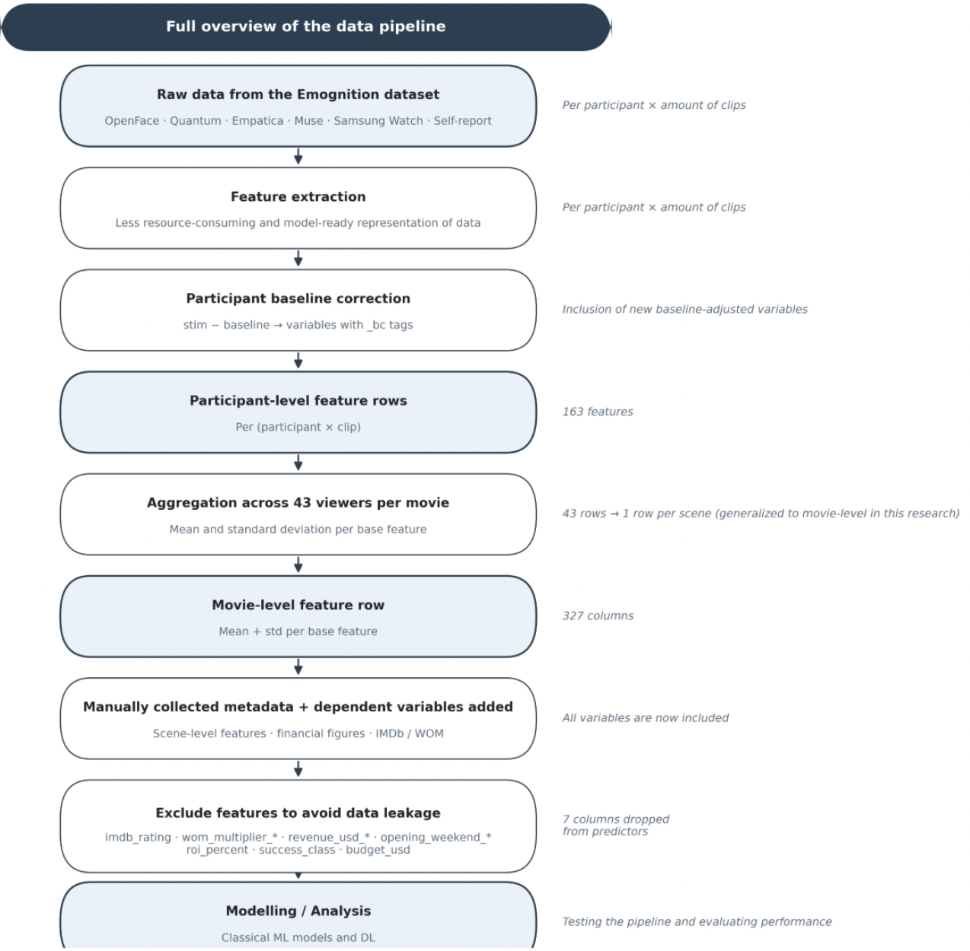

Slide 5
Discussion on methodology
- Models are selected with diversity of assumptions in mind: linear vs non-linear, parametric vs non-parametric, ML vs DL
- This enables cross-method convergence as validation framework and justification of observed signals
- Standard significance testing is hard because of n=10
- Data simulation enables cross-validation procedures. Two tracks are used and conclusions need to reproduce on both.
- The pipeline was designed with deployment in mind: wearable hardware, feature extraction and aggregation, scalable in dimensions of participants, movies, and stimuli durations

Slide 6
Crucial empirical findings
- IMDb ordering at ρ = 0,82 (rho) with simulated data training and real testing
- Perception predicted approx. 2 times better
- Flop detection better in terms of classification, bounded by framing and data
- Physiology contains most signals in the data, even including self-reports
- Prediction ceiling achieved due to data bottleneck: thesis findings are mostly reported as patterns not necessarily as point estimates or in terms of feature importance. n = 10 limits what the reasonably defensible claims of the thesis can be

Slide 7
Challenges during the research and writing process
- Single biggest challenge is data (Emognition dataset limits the thesis but has advantages in practicality ,scalability, variety of data)
- Constructing the outcome variables (data availability issues, biases, quantifying profitability and perception has to be a complicated formula but that would not work on n=10)
- Setting the scope of research (could have focused on optimizing a DL model or taking the issue as a computer vision problem)
- Lots of method decisions had to be made: London 2012 outlier, inflation adjustment, clip vs full film generalization, lab vs theatre environment difference
- Data contains no genuine commercial failures: clear limitation since what we observe are mediocre and high-performing projects

Slide 8
Pipeline extension, improvement possibilities
- Learn signals from the temporal structure of the data that is discarded by movie level aggregation and feature extraction (DL on raw signals)
- Try other augmentation methods or combine with other datasets
- Joint learning methods to combine perception and profitability, learn signals from their shared structure, patterns
- Utilize the raw video recordings, not just the processed version
- Try different outcome variables to represent vague concepts of perception and profitability (tradeoff between noise and complexity)

Slide 9
Further research ideas and result improvements
- Most importantly, involve more data to break the ceiling set by n = 10
- Wider variety of films, participants, more focused geographical areas
- Test the pipeline in a real-life movie theatre scenario to validate the transition from lab environment
- Extensive comparison study of thesis results to existing literature (only partially done currently)
- Analysis focusing on genre differences

